Slide 1
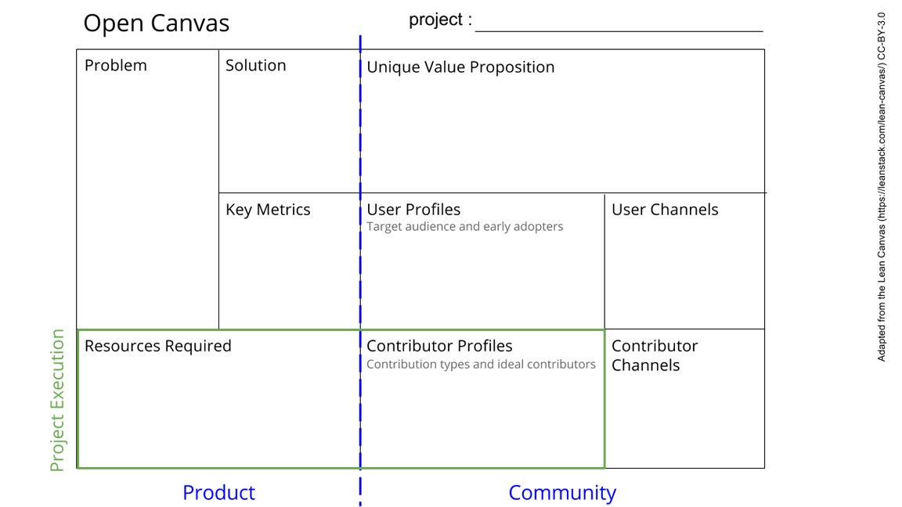
OpenHeart Project
Lack of collaboration in field of mechanical circulatory support
Lack of open resources / data sharing / standardization
Lack of open educational tools
Create open-source community/network to improve collaboration
Open-source data repositories
Develop educational tools
Offering a space for researchers to share their work and resources for the benefit of the whole community
Improved research practices for improved research outcomes
Improved education and training
# of active people/labs
# of created repositories
Contacting laboratories and researcher directly
Presenting at conferences
PhD students / emerging researchers in MCS
Senior researcher as mentors
Software solutions to connect people / share data (mostly in place, needs documentation)
Development
Design (website / animations / videos)
Developer / Designer for tutorial videos / animations
PhD students / researcher for beta testing
Contacting Unis for project students
See next slide for instructions!
Notes:
Go to File > Make a Copy… to make your own canvas
See next slide for instructions

Slide 2
